Slide 1


WebGIS Lab 5
DEBAYAN MANDAL

Slide 2
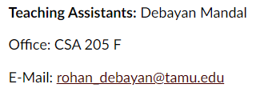
Lab Hours
Notes:
Please mail me before. Don’t wait till the submission date.

Slide 3
Learning Outcomes (JS)
Setting up a Leaflet map
Working with markers, polylines and popups
Dealing with events.

Slide 4
What is Leaflet?
Leaflet is the leading open-source JavaScript library for mobile-friendly interactive maps. Weighing just about 38 KB of JS, it has all the mapping features most developers ever need.
Open this: Download - Leaflet - a JavaScript library for interactive maps (leafletjs.com)

Slide 5
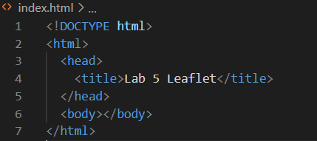
Preparing your page
Create a new html file with basic components

Slide 6
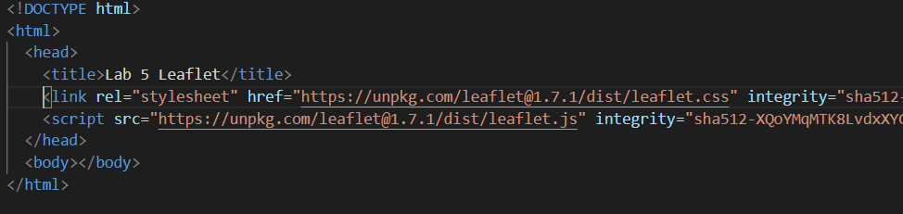
Preparing your page
Include Leaflet CSS and JavaScript file in the head section of your document:
You can find it in the link from slide 4
Always put the JavaScript before CSS.

Slide 7
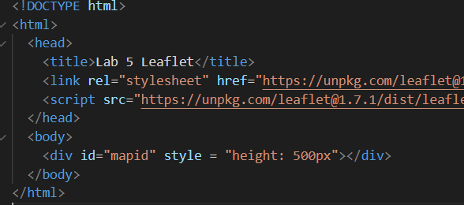
Preparing your page
Put a div element with a certain id where you want your map to be:

Slide 8
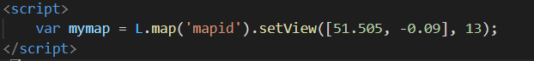
Setting up the map
Let’s create a map of the center of London with pretty Mapbox Streets tiles. First, we’ll initialize the map and set its view to our chosen geographical coordinates and a zoom level:

Slide 9
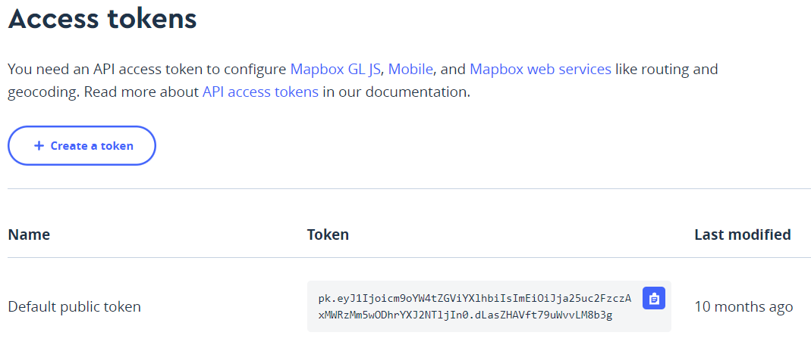
Setting up the map
In this example we’ll use the mapbox.streets tiles from Mapbox’s Streets (in order to use tiles from Mapbox, you must also request an access token).
Account | Mapbox
Notes:
Streets Map Style | Mapbox
Gallery (mapbox.com)

Slide 10
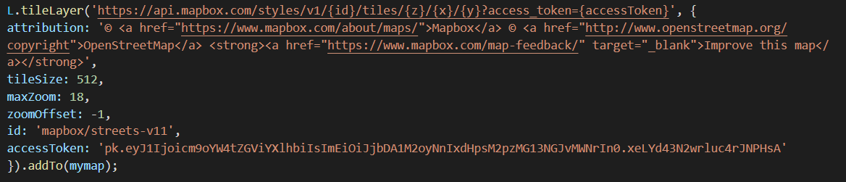
Setting up the map
Next, we’ll add a tile layer to add to our map, in this case it’s a Mapbox Streets tile layer. Creating a tile layer usually involves setting the URL template for the tile images, the attribution text and the maximum zoom level of the layer.

Slide 11
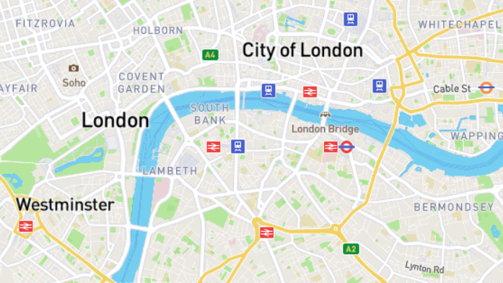

Slide 12
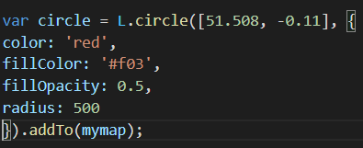
Markers, circles and polygon
Besides tile layers, you can easily add other things to your map, including markers, polylines, polygons, circles, and popups. Let’s add a marker:
Adding a circle is the same (except for specifying the radius in meters as a second argument), but lets you control how it looks by passing options as the last argument when creating the object:

Slide 13
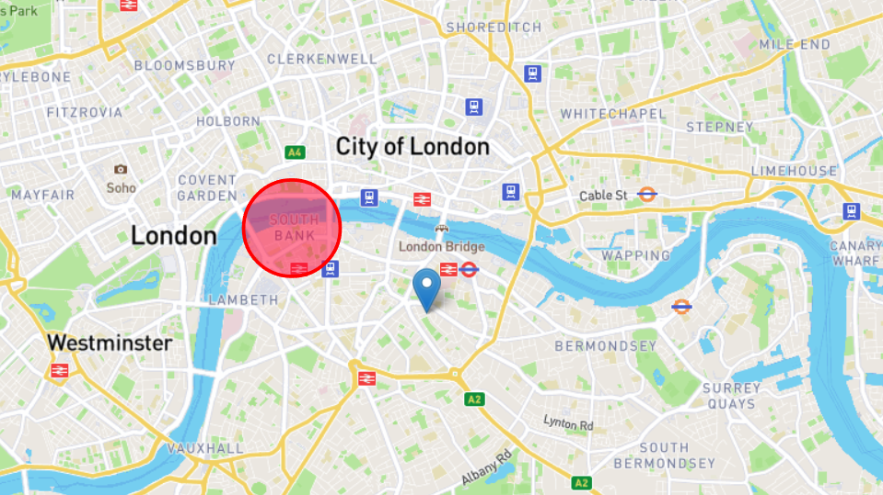

Slide 14
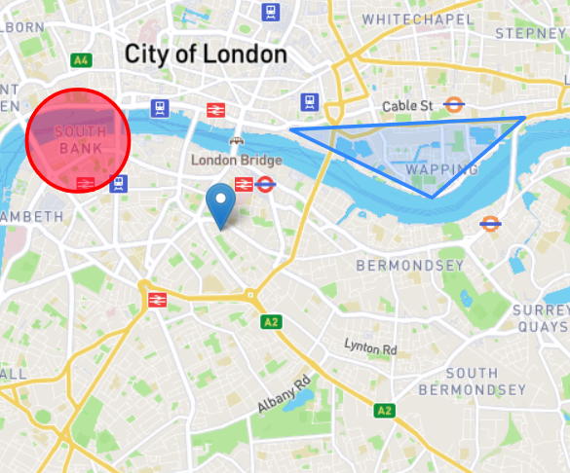
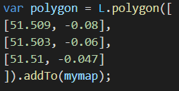
Adding a polygon is as easy:

Slide 15
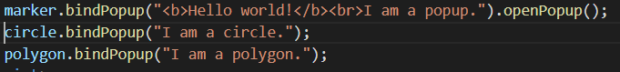
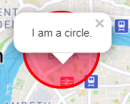
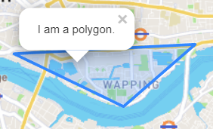
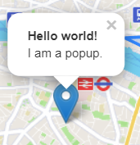
Working with popups
Popups are usually used when you want to attach some information to a particular object on a map. Leaflet has a very handy shortcut for this:

Slide 16
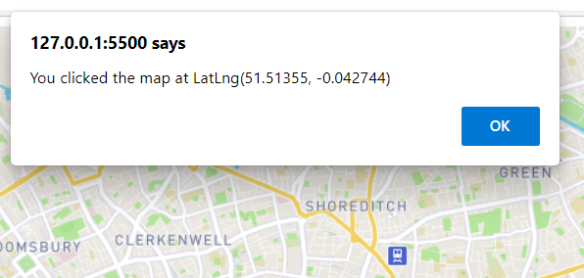
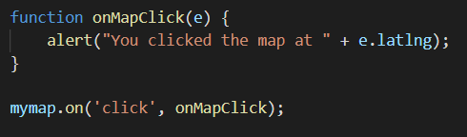
Dealing with events
Every time something happens in Leaflet, e.g., user clicks on a marker or map zoom changes, the corresponding object sends an event which you can subscribe to with a function. It allows you to react to user interaction:

Slide 17
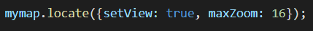
Geolocation
Leaflet has a very handy shortcut for zooming the map view to the detected location — locate method with the setView option, replacing the usual setView method in the code:
Allow the browser to know your location.
Then run away before the aliens find you.

Slide 18
Task 1: -
Finish the first three online Leaflet tutorials - create working HTML pages in your repo for each of the tutorials
Tutorial 1: Leaflet Quick Start Guide
Tutorial 2: Leaflet on Mobile
Tutorial 3: Markers With Custom Icons

Slide 19
Task 2: -
Build a custom web map that integrates each of the tutorials
give your webpage a title e.g., "Your name First Web Map"
zoom the map view to the detected location using locate method
draw a circle around the Kyle Field with a popup
create custom icons with popups for O&M and Academic Building
create an event which enables you to see the coordinates in an alert when you click on the map

Slide 20
To Hand In
GitHub (4 html files):
Upload 4 html files (one for each tutorial and one for custom web map) to your lab05 folder
Canvas:
Open the Custom_Map.html you created in a browser and take a screenshot of your custom map and upload it.
Take screenshots of your online tutorials and send them.
Submit the link to your GitHub lab05 folder.
Due Date: Next Week

Slide 21
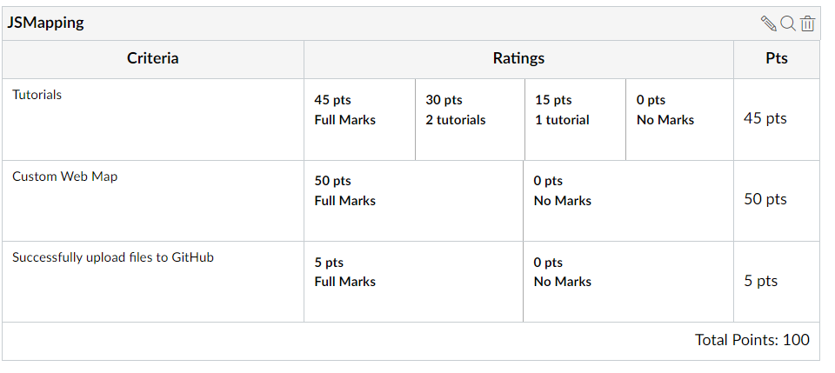
To Hand In
Notes:
All tasks, including labs, homework, and reports will have 5% point reduction for the late submission.

Slide 22
Thank You
Any Questions?

